Slide 1

C2HLSC
Using LLMs to Bridge the
Software-to-Hardware Design Gap
Luca Collini

Slide 2
Flow Overview
Two steps flow:
Code Fixing
Code Optimization

Slide 3
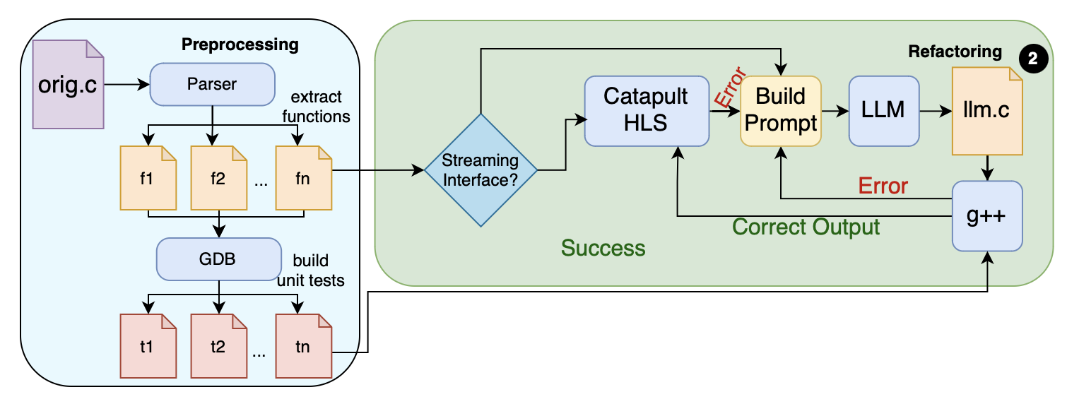
Code Fixing

Slide 4
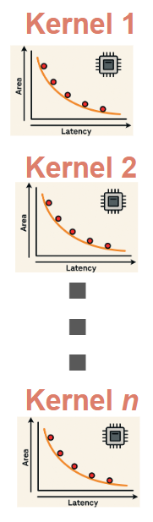
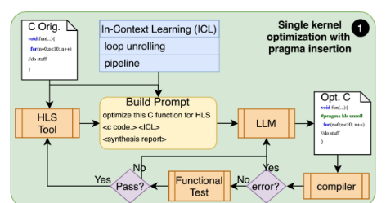
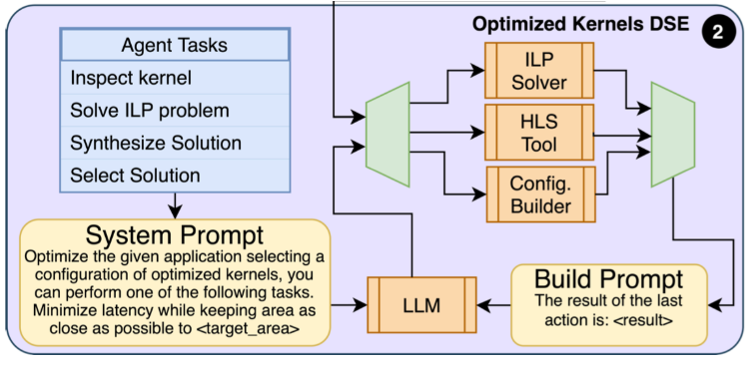
Code Optimization
Single Kernel Optimization
Full System Composition

Slide 5
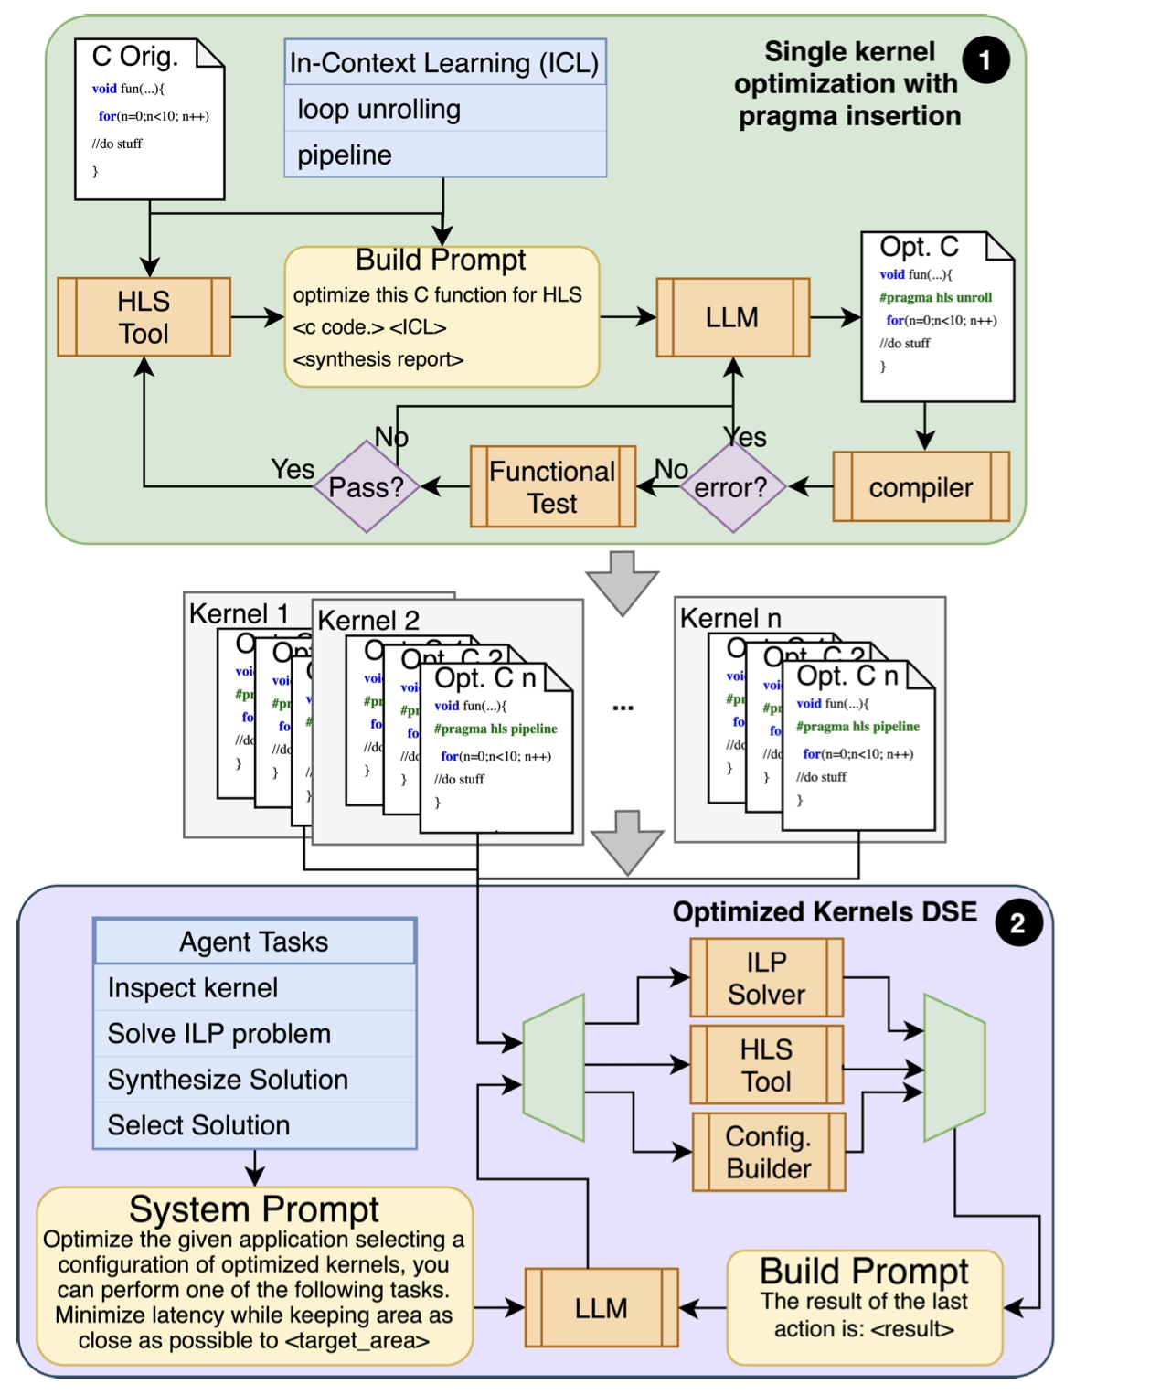
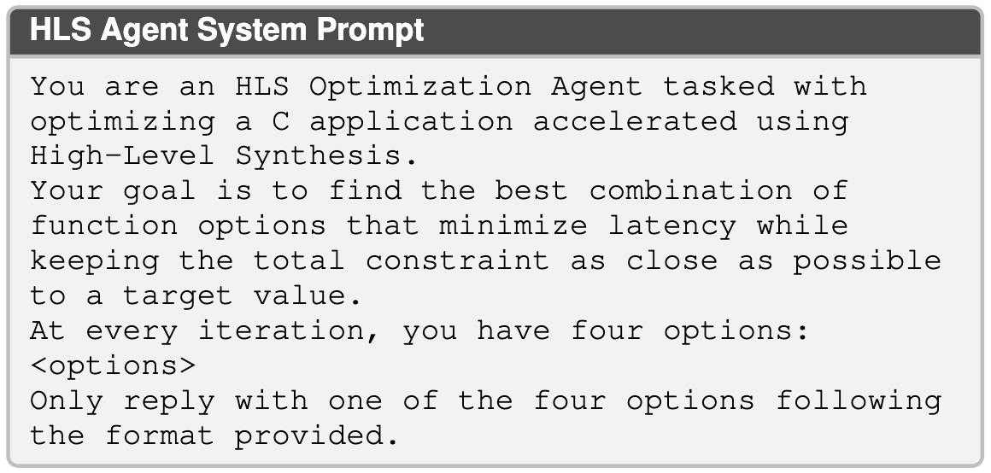
DSE of optimized kernels
Notes:
Get rid of prompt

Slide 6
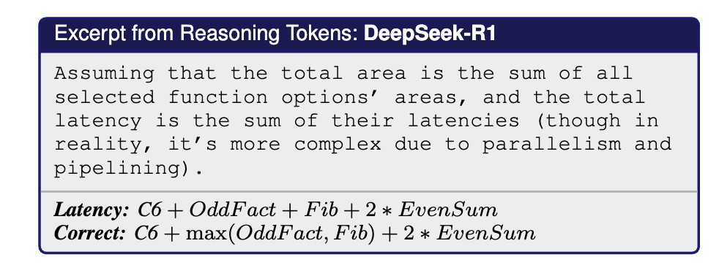
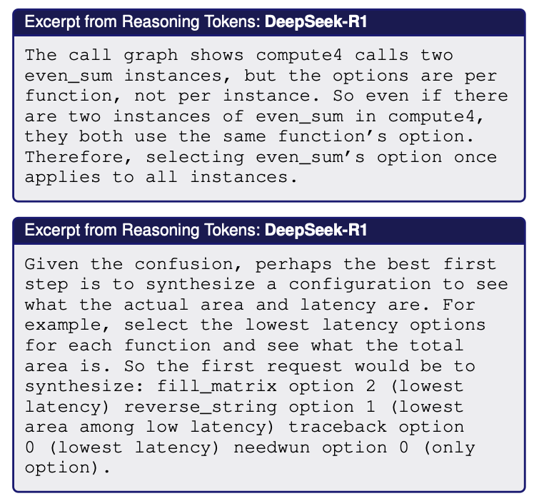
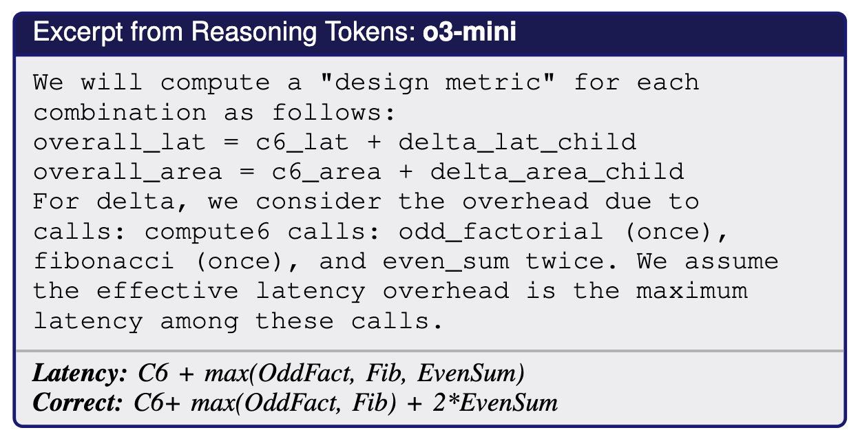
Results: Agentic Flow for Optimization

Slide 7
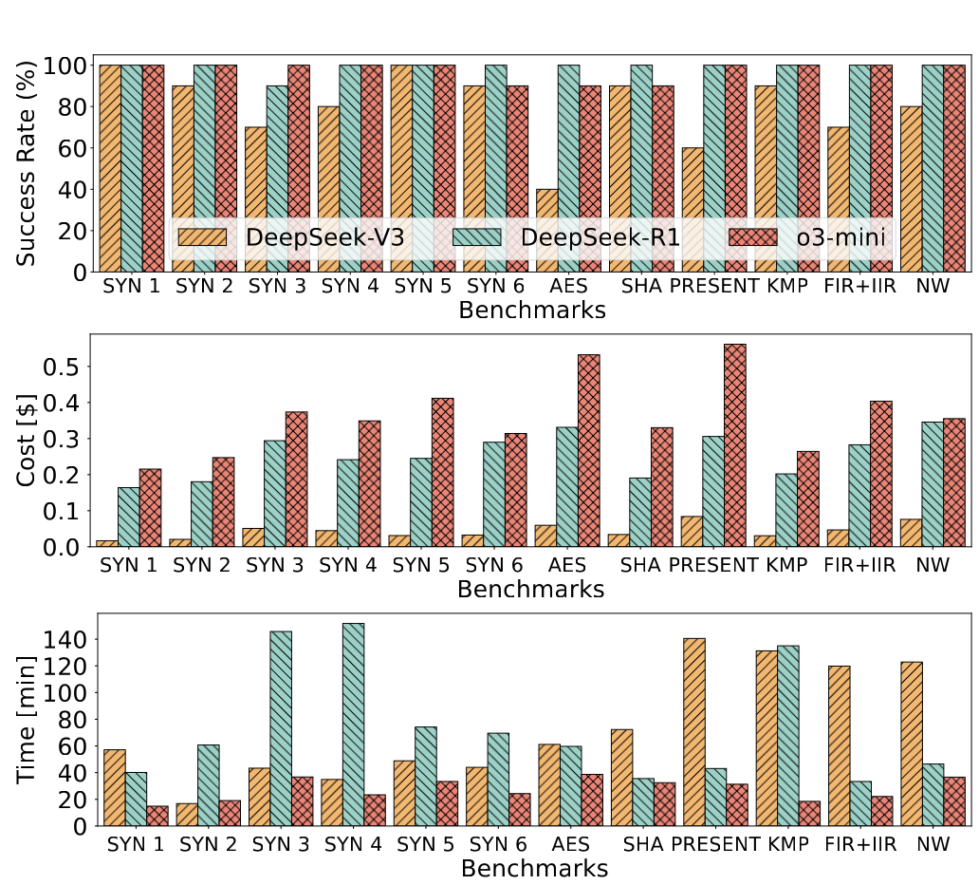



Success & Cost
Finds a Solution
Failure modes:
Context Window Limit
Iteration Limit
# Tokens
x
Cost per token
Early-stage Deepseek API downtime-slowness challenges

Slide 8
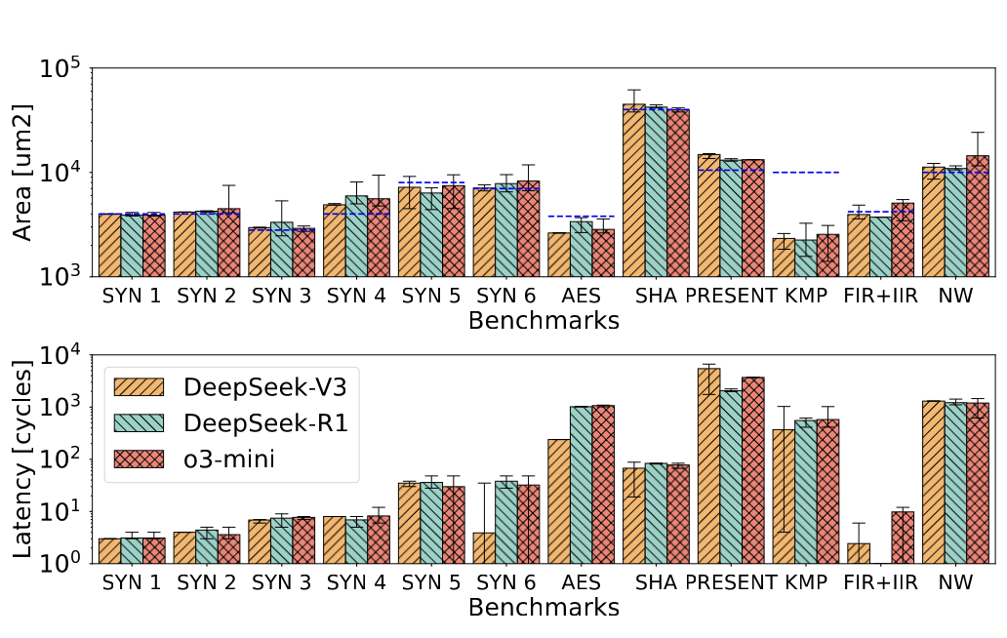
Results: agentic flow for optimization
Synthesis results are comparable across models

Slide 9




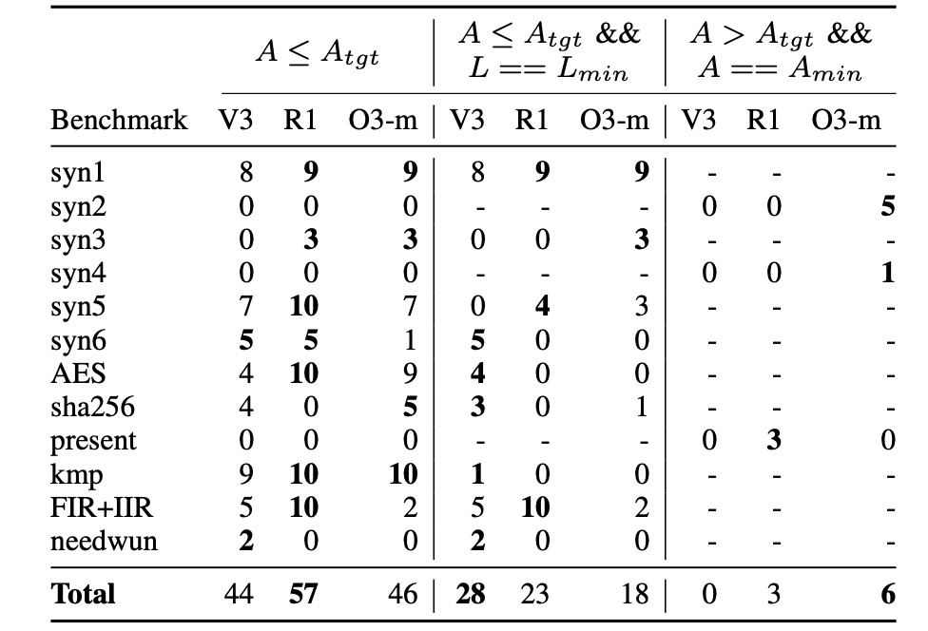
Results: agentic flow for optimization

Slide 10

Demo

